Slide 1
Simplifying the Code First Approach in the Entity Framework
Dhananjay Kumar
Infragistics Consultant
Microsoft MVP http://debugmode.net

Slide 2
Host : Dhananjay Kumar
Infragistics Consultant
6 times Microsoft MVP
@debug_mode
Blog : http://debugmode.net
Email : debugmode@outlook.com

Slide 3
Agenda
About Code First Approach
Create first database
Managing connection strings
Data Annotations and Fluent API
Relationship between entities using the Annotations
Database initialization and seed methods
Enabling migrations
Update database
Database creation strategies

Slide 4
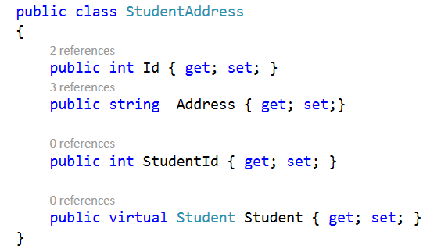
Code First approach
Database first approach
Database modelling
Database first approach
Code first approach
DB
Code First approach
DB

Slide 5
Code First approach
Database gets created from the domain entities
First we model entities and relationship in classes and then database gets created from that
Easy for database migration and seeding.
Very useful for domain driven development

Slide 6
Code First approach
Develop without ever having to open a designer or define an XML mapping file
Define your model objects by simply writing “plain old classes” with no base classes required
Optionally override the convention-based persistence and use a fluent code API to fully customize the persistence mapping
Use a “convention over configuration” approach that enables database persistence without explicitly configuring anything

Slide 7
Summary
About Code First Approach
Create first database
Managing connection strings
Data Annotations and Fluent API
Relationship between entities using the Annotations
Database creation strategies
Database initialization and seed methods
Enabling migrations
Update database

Slide 8
What Infragistics can offer you?
We welcome all of you to take advantage of a FREE 30 Day Trial by downloading the product at: http://www.infragistics.com/products/ultimate/download
Please reach out to us at Sales-India@infragistics.com for any follow up questions you may have. We welcome the opportunity to assist you.

